Slide 1

Sales & Promotion Analysis
Md Kalim Ansari
Data Analyst
Notes:
Hello Guys, I am Md Kaleem Ansari, a data analyst, I have completed Codebasics 9th Challenge,, it is on sales & promotion analysis, lets explore the analysis…….

Slide 2
Introduction
AtliQ Mart is a retail giant with over 50 supermarkets in the southern region of India.
All their 50 stores ran a massive promotion during the Diwali 2023 and Sankranti 2024 (festive time in India) on their AtliQ branded products.
Now the sales director wants to understand which promotions did well and which did not so that they can make informed decisions for their next promotional period.
Notes:
Here, comes the introduction, basically the problem statetement,,,,,
[Repeat the slide]

Slide 3
Store Performance Analysis
Notes:
Now comes to the Store performance analysis…..

Slide 4
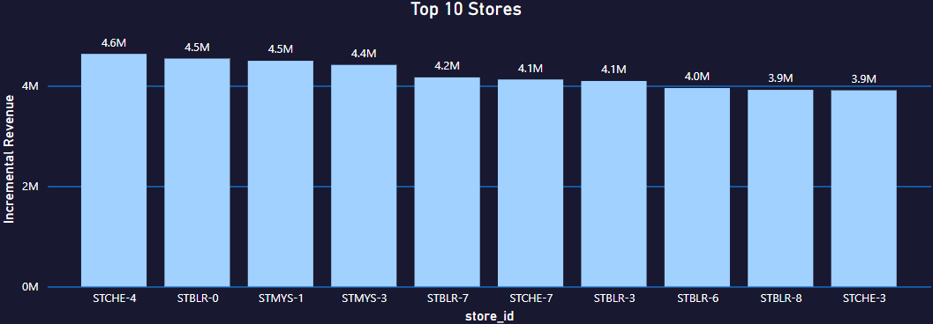
Top 10 stores in terms of Incremental Revenue (IR) from the promotions
Store STCHE-4 performs very well amongst all the Stores
Notes:
Here, the question is, what are the Top 10 stores in terms of Incremental Revenue (IR) from the promotions?
We can see that from bar chart that Store STCHE-4 performs very well amongst all the Stores
Lets.. Come to the next slide

Slide 5
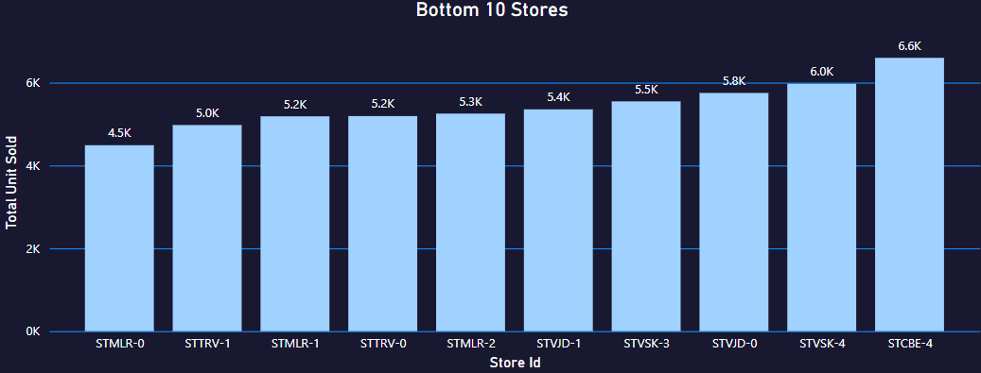
Bottom 10 stores who sold less units during the promotional period
Store STMLR-0 performance is very low
Notes:
Here, the question is, what are the Bottom 10 stores who sold less units during the promotional period?
We can see that from bar chart that Store STMLR-0 performance is very low
Lets.. Come to the next slide

Slide 6
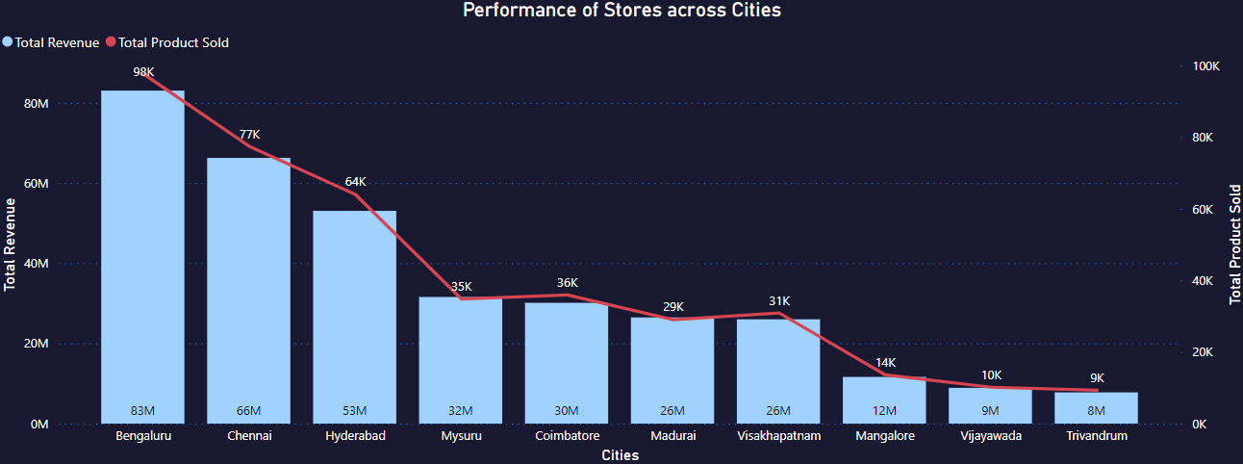
Performance of Stores across Cities
Bengaluru, Chennai & Hyderabad performed very well
Notes:
Here we analysing Performance of Stores across the Cities , here bar chart is indicating Total Revenue & Line chat is indicating total product sold here we can see that Bengaluru,Channai , & Hydrabad performed very well

Slide 7
Promotion Type Analysis
Notes:
Now comes to the Promotion Type Analysis…..

Slide 8
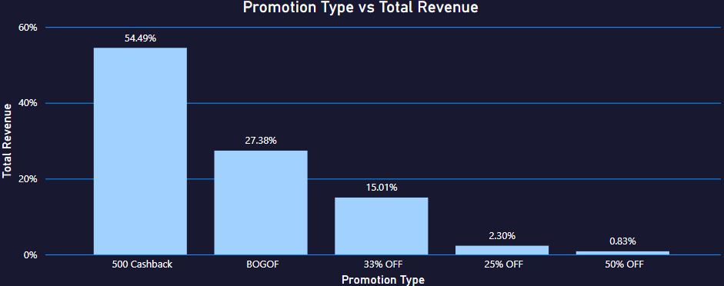
Top 2 promotion types that resulted in the highest Incremental Revenue
500 Cashback & BOGOF promotion type has the highest incremental revenue
Notes:
This bar char shows the highest Revenue for the different promotion types here we can see from the graph that 500 Cashback & BOGOF promotion type has the highest incremental revenue

Slide 9
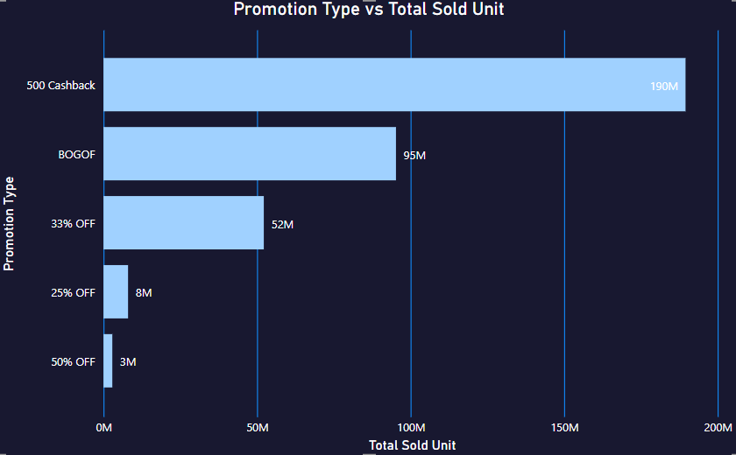
Bottom 2 promotion types in terms of Incremental Sold Units
50% OFF & 25% OFF are the 2 bottom promotion types
Notes:
This bar char shows the incremental sold units for the different promotion types here we can see from the graph that 50% OFF & 25% OFF are the 2 bottom promotion types which has not performed well

Slide 10
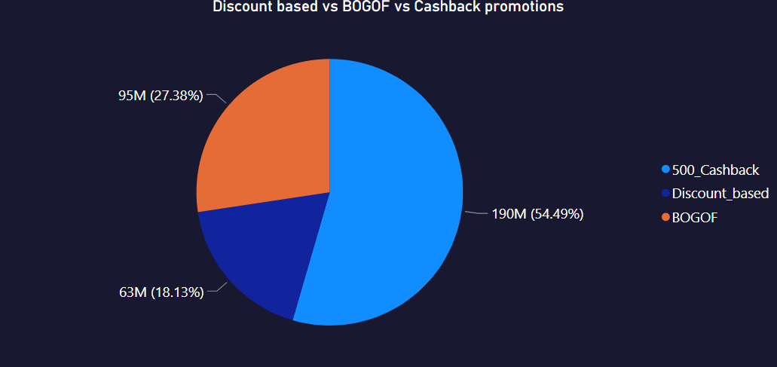
Difference in performance of Discount based vs BOGOF vs Cashback promotions
500 Cashback & BOGOF type of promotion comprises 81.87% of Total Revenue
Notes:
This is the performens analysis of Discount based vs Buy one get one free vs Cashback promotions here we can see fron the pie chart that 500 Cashback & Buy one get one free type of promotion comprises 81.87% of Total Revenue

Slide 11
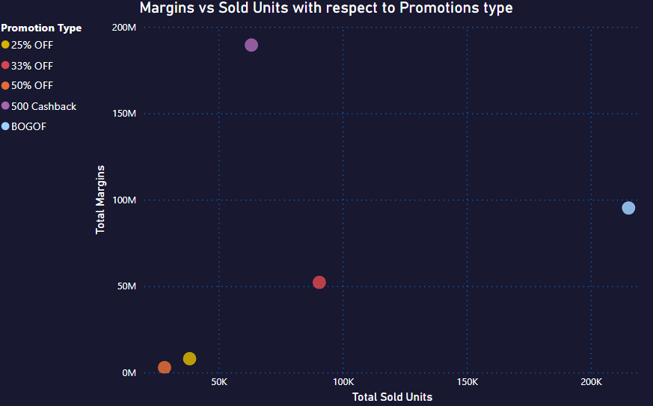
Which promotions strike the best balance between Incremental Sold Units and maintaining healthy margins?
BOGOF promotion type strikes the best balance
Notes:
Here the question is Which promotions strike the best balance between Sold Units and maintaining healthy margins? For this analysis we have used Scatter plot
In the X axis we have taken Total sold units & Y axis we have taken total mergins , diff.coloured bubbles shows the diff. promotions type so we can see from the graph that BOGOF promotion type strikes the best balance
in the Y axis we have taken Total Margins

Slide 12
Product & Category Analysis
Notes:
Now comes to the Product & Category Analysis…..

Slide 13
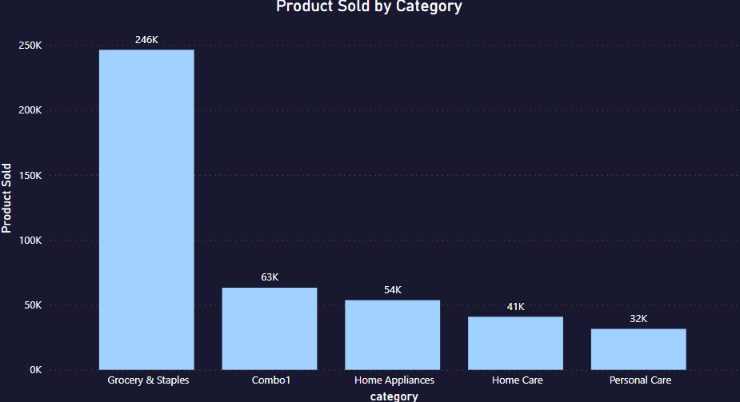
Which product categories saw the most significant lift in sales from the promotions?
Grocery & Staples shows the highest sales
Notes:
The question is which product categories sow the highest sales we can see from the bar chart that Grocery & Staples shows the highest sales

Slide 14
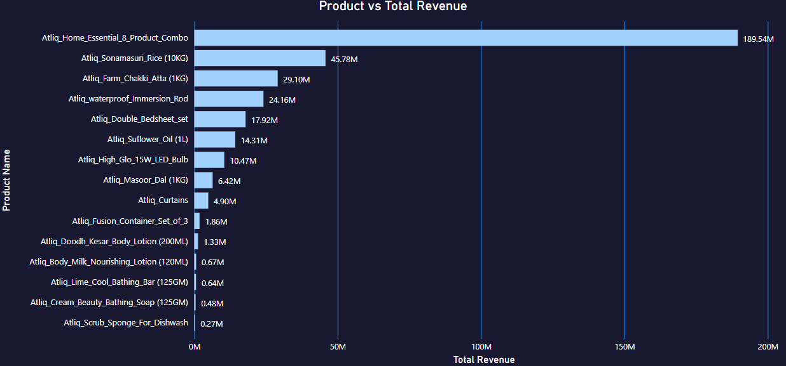
Products that respond exceptionally well or poor to the promotions
Green colour box performed well where as red colour box performed poorly
Notes:
Now the question is which are the product that respond exceptionally well or poor to the promotions here we see from the bar chart that Green colour box products performed well where as red colour boxproducts performed poorly

Slide 15
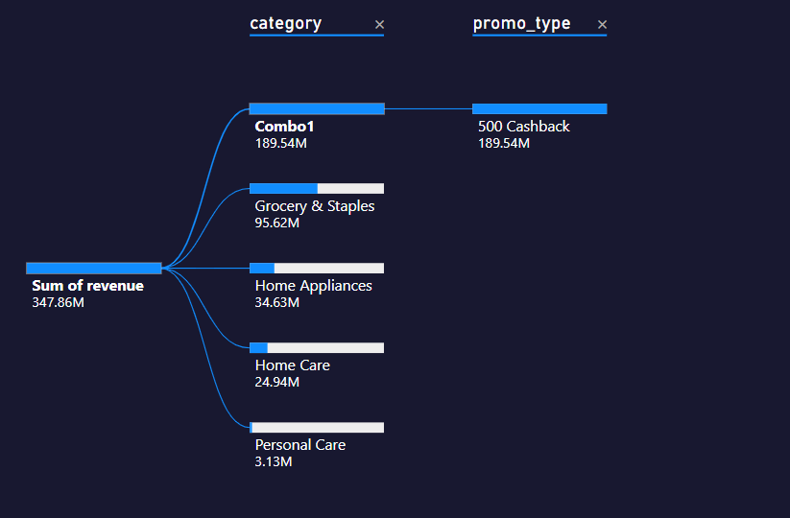
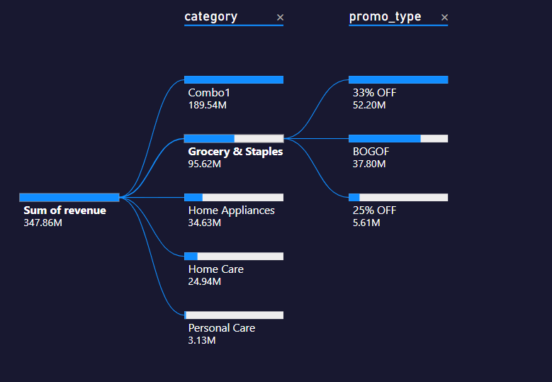
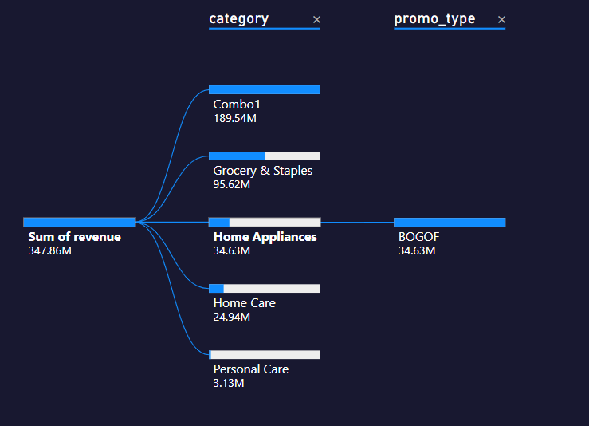
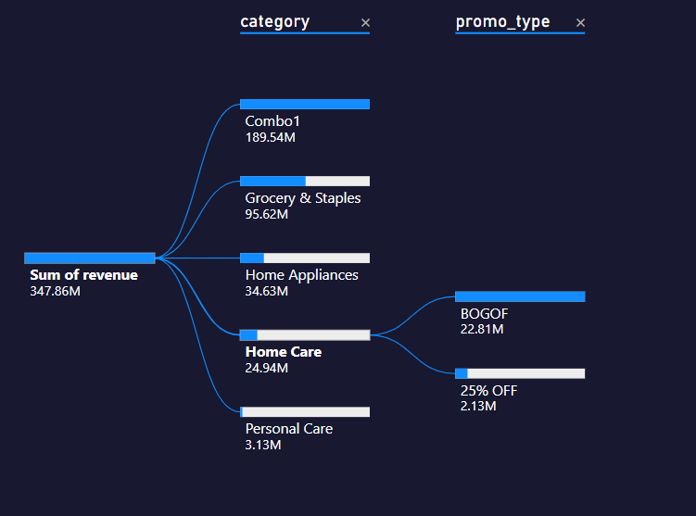
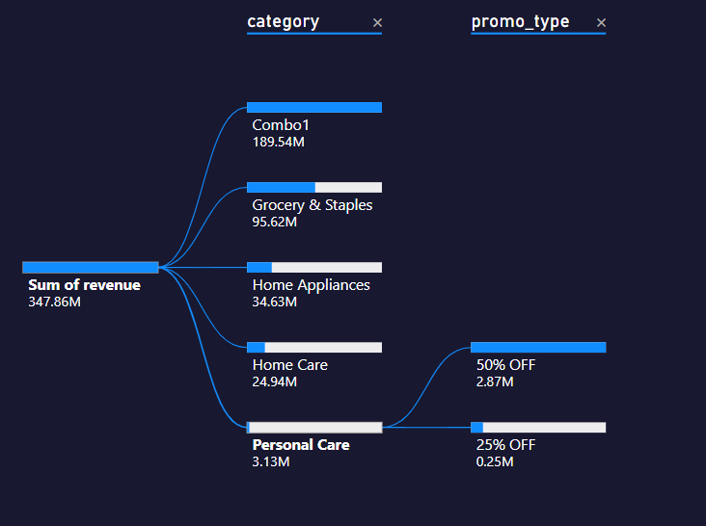
Correlation between product category & promotion type effectiveness
Notes:
Here, we have used decomposition tree to show the correlation between effectiveness of product category & promotion type
In this we have analysed the total sum of revenue which is on left side using category and promotion type as branches or nodes
In this we have 5 categories, [name], [revenue] now we will analys categories one by one in more details ,now comes to the 1st category combo1, it’s revenue is fully coming from 500 Cashback promo type , now comes to 2nd category ………….,

Slide 16
Adhoc Business Requests using MySQL
Notes:
Now comes to the Adhoc Business Requests using MySQL

Slide 17

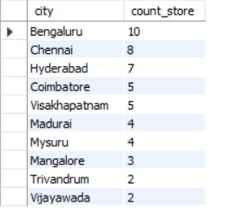

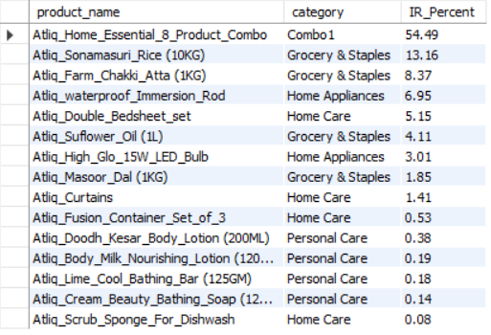
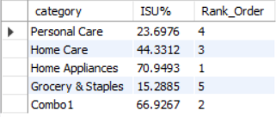
List of products with a base price greater than 500 & promo type of 'BOGOF'
Number of stores in each city in descending order
Total revenue generated before & after the campaign
Top 5 products, ranked by Incremental Revenue Percentage (IR%), across all campaigns
Incremental Sold Quantity (ISU%) for each category during the Diwali campaign & provide rankings
Notes:
For, this adhoc requests, we have used mysql for getting the results,
the screenshot of results has shown here…
This is the 1st one, 2nd one…………

Slide 18
Thank You
Notes:
Thank you for listening me
Bye.. Take care…

